Slide 1
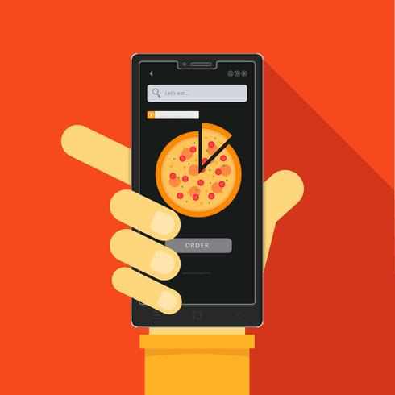
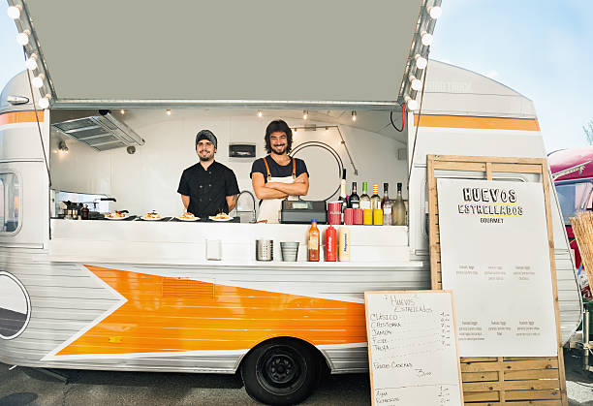

Food 4 Thought
Lukasz Bakun, Anya Biryukova, Hayeon Choi, Gabriel Smith-Dalrymple

Slide 2
Our Big Idea
Create an application that students and staff can use to find food on/near campus, complete with menus, hours, locations, and reviews.
Enable users to order their food in advance so that they can pick up their food without waiting in line.
Compile an easy to access list of food local to UWB to allow students the ease of finding what they would like to eat.
Enable users to filter by preferences and food allergies, and allow account holders to save preference settings.
Notes:
Hannah

Slide 3
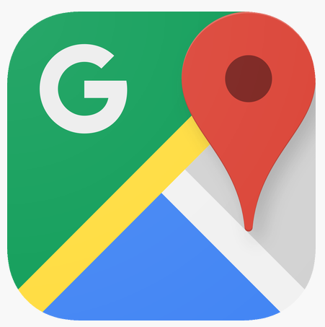
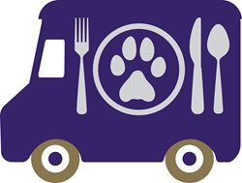
Current Existing Solutions
Google Maps
UWB Dining Services Page https://www.uwb.edu/food
Uber Eats
Yelp
Notes:
Hannah

Slide 4
Top Target Personas
Studious Sandra: Full-time student and a part-time waitress that lives off campus. Tries to fit all her classes in on similar days and has short breaks between classes. Works hard to keep up her grades.
Allergic Angela: Full-time student that wants to make sure that there is no chance of peanuts or almonds being found in her food. Lives on-campus, and parents pay for college. Her budget is fairly open, so she can focus on keeping her food allergy free.
Single Dad Daniel: Only goes to class for 5-10 credits a quarter, but works a full-time job. His busy schedule makes it tough for him to be able to find time to get food as he’s always traveling between work, class, and his local daycare.
Notes:
Lukasz

Slide 5
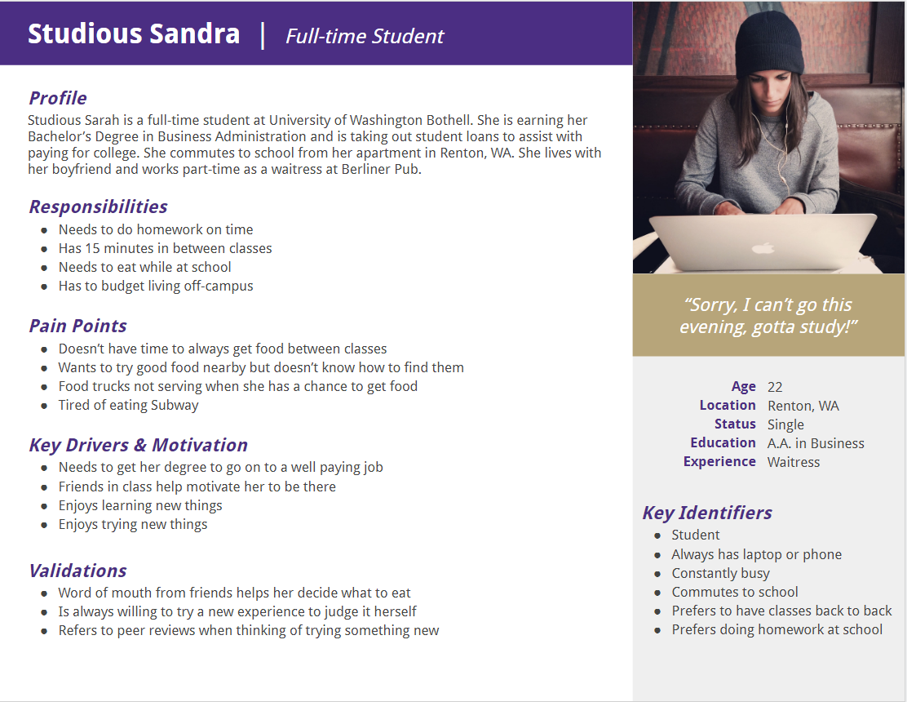
Notes:
Lukasz

Slide 6
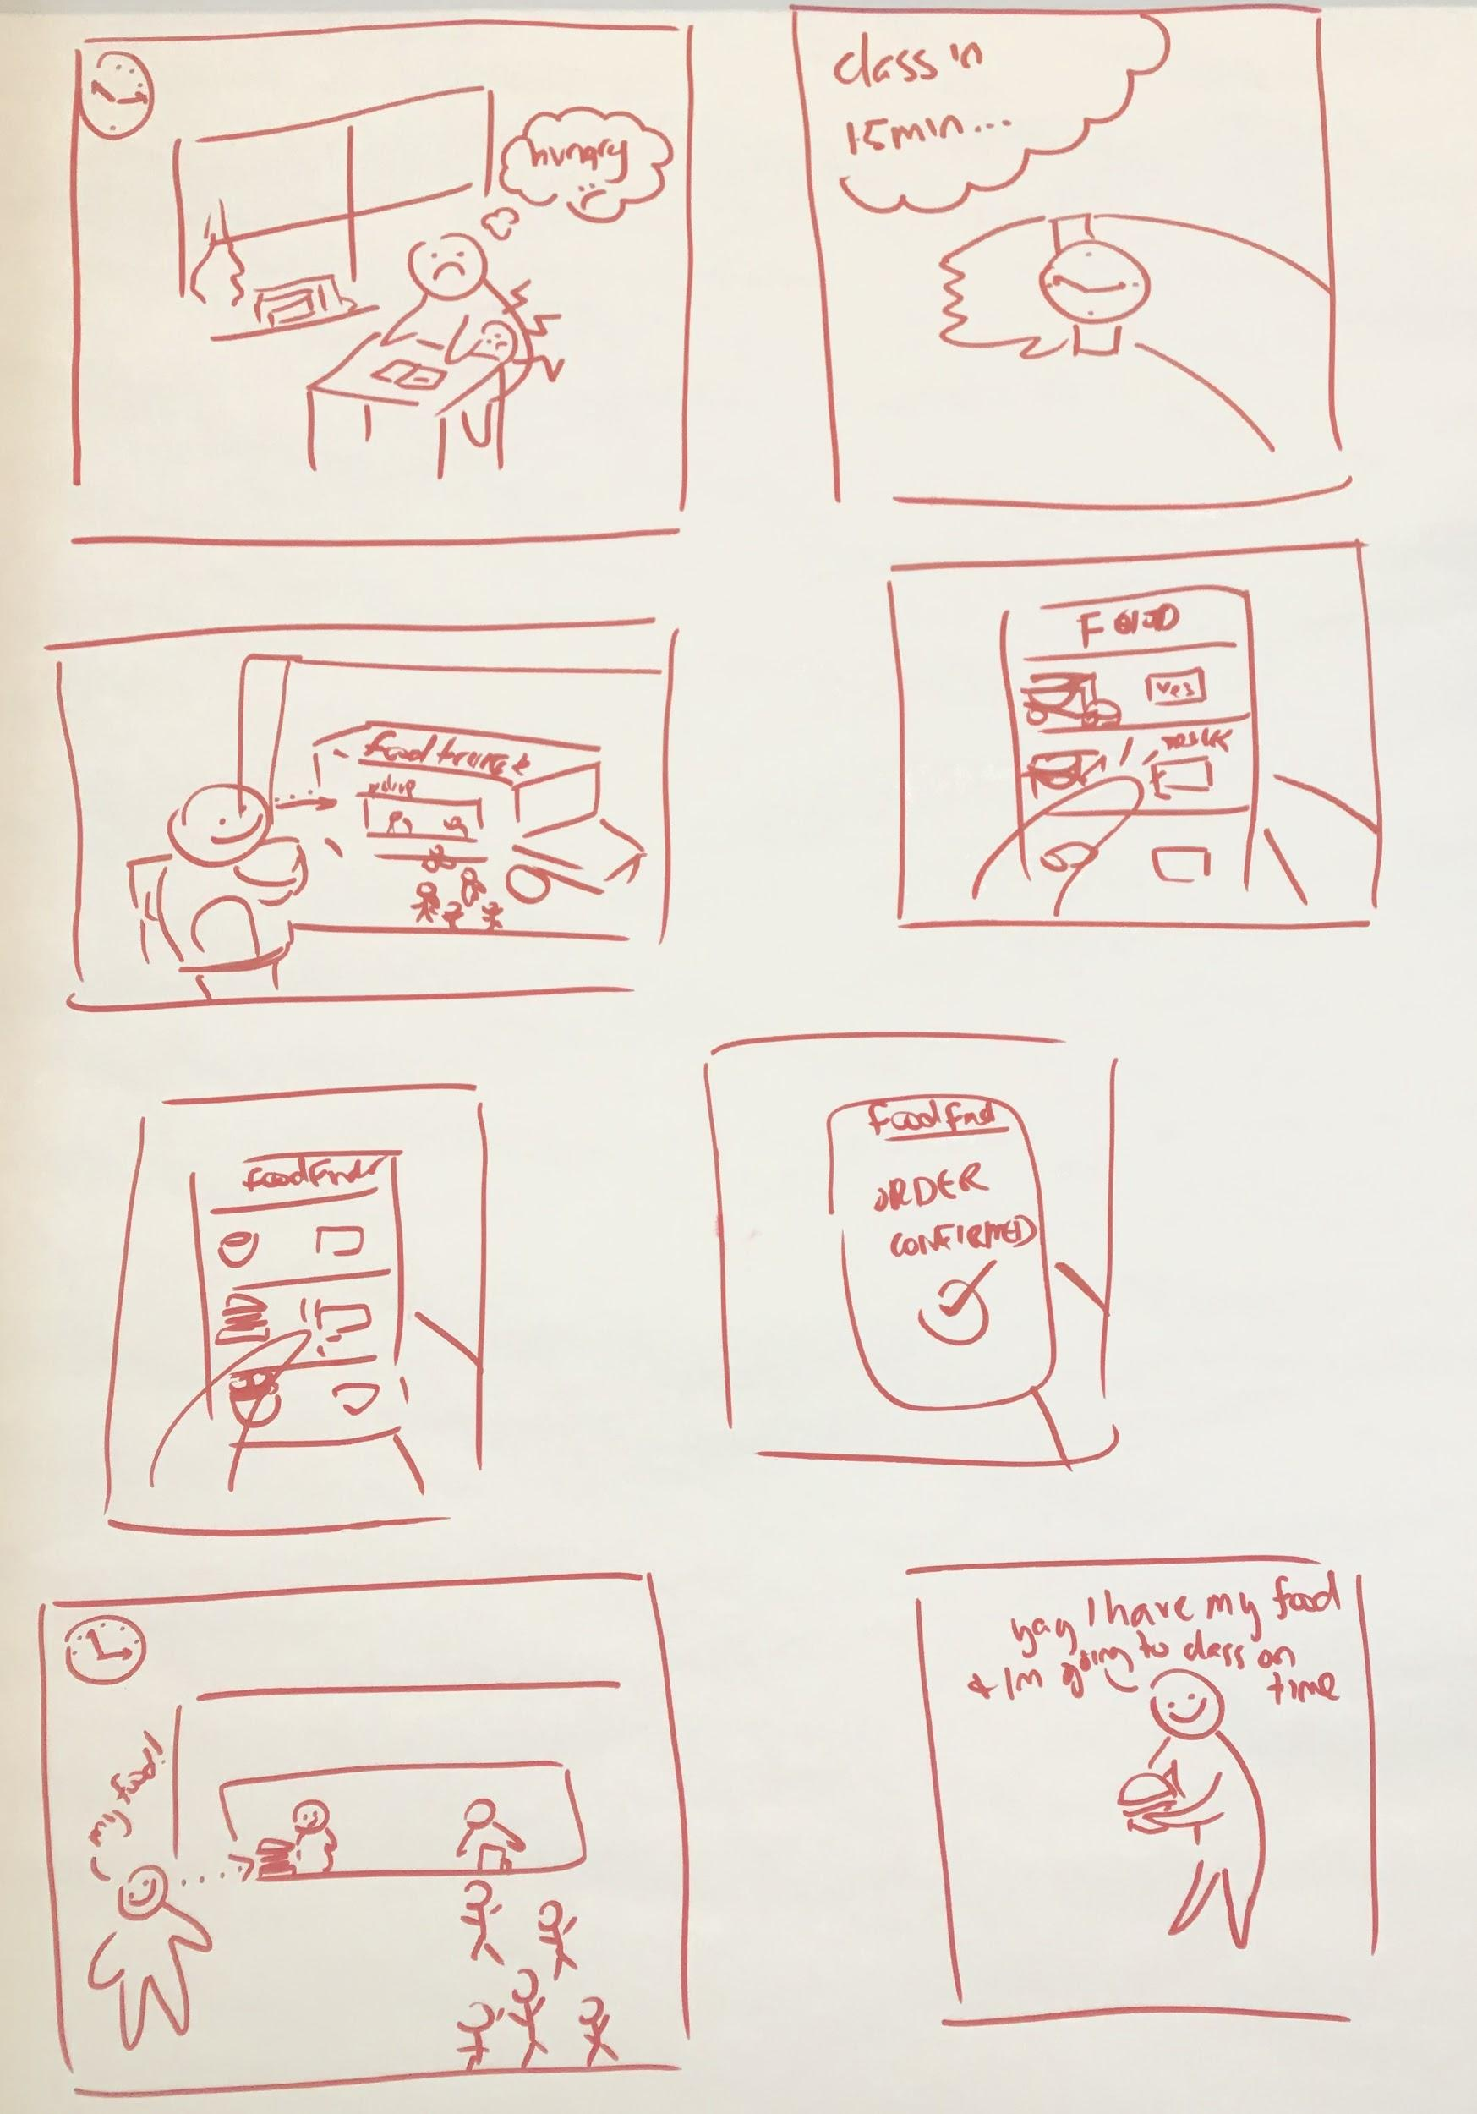
Example Delighter Scenario
A student is in class and looking to get food from a food truck before their next class, which is in 15 minutes.
The student uses the app to find the food truck
The student places an order to pick up during their class break.
The student doesn’t have to wait in the long line, and gets their food before their next class starts.
Notes:
Anya

Slide 7
User Research
A lot of students don’t know the local food options and are not too aware of the food truck schedule, deterring them from eating while on campus.
Students find the lines for the food trucks too long.
Students have found pricing for eateries too expensive for their budgets.
Students sometimes feel the quality of food is poor.
Notes:
Anya

Slide 8
High Level Design
Food 4 Thought app
Configuration Services
Identity Management Application Management
Application Services
History Archive Online Ordering Previous Order Saving Ingredient Lists Allergy Archive Food Requests Location Display Help
Utility Services
Authentication Logging and Monitoring Interfacing User Storage Search
Notes:
Gabriel

Slide 9
Big Issues/Risks
Campus may have limitations and restrictions on what food trucks are allowed to serve campus.
Demand may not be great enough to encourage more food trucks to serve the campus.
Food trucks may be discouraged from potential negative user reviews on the app.
Notes:
Gabriel

